Slide 1
NE 591: Advanced Reactor Materials
Fall 2021
Dr. Benjamin Beeler

Slide 2
advanced cladding

Slide 3
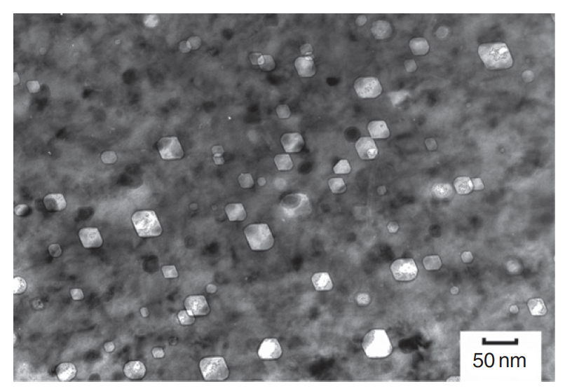
The need for advanced cladding
Austenitic stainless steels are widely used as structural components in nuclear service
At high dose, the microstructure develops a high concentration of voids, leading to dramatic swelling
Swelling of cladding in FFTF and BN-600
Void swelling in 304SS

Slide 4
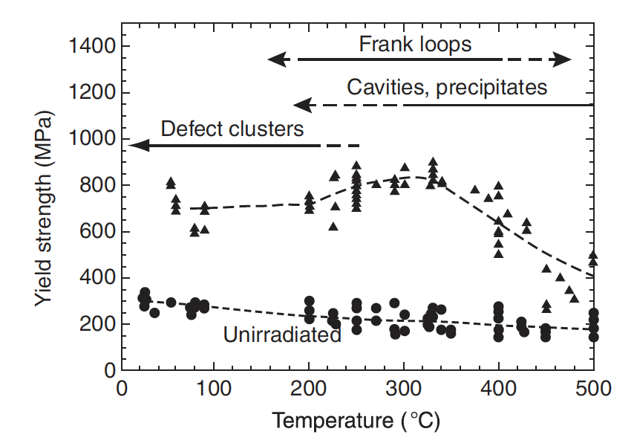
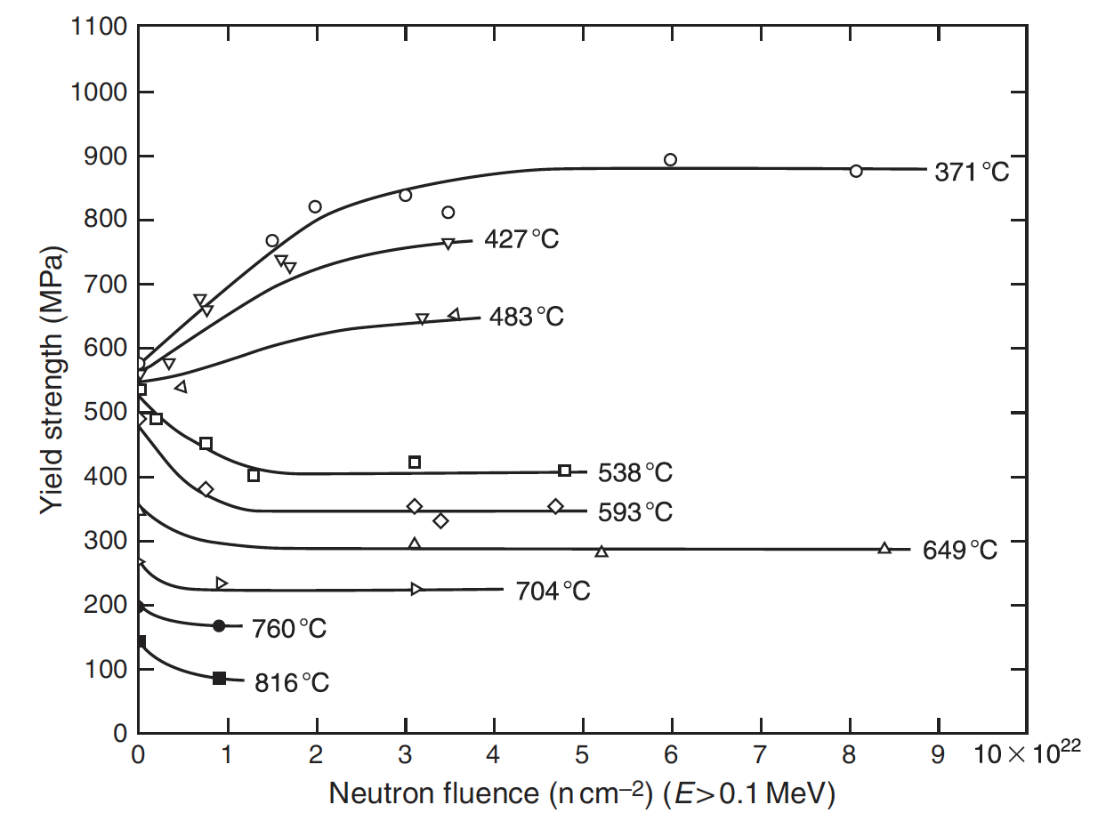
The need for advanced cladding
In addition to high fluence, high temperature contributes to void swelling
SS significantly weakens with increasing temperature
Thus, their applicability is limited in advanced reactor systems

Slide 5
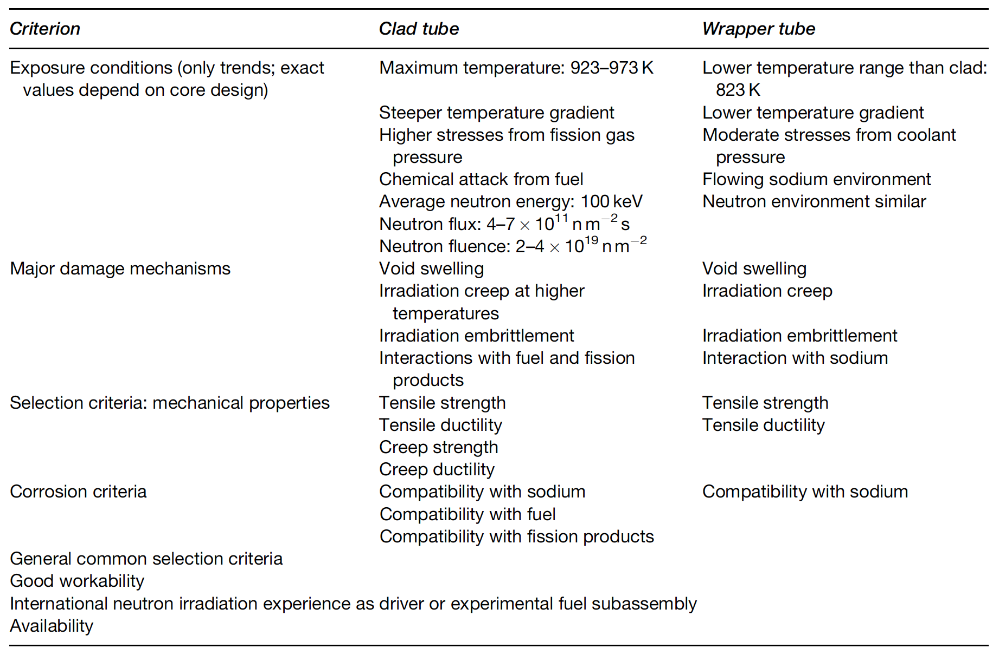
Fast Reactor Conditions
The structural components experience a different environment in advanced fast reactors than those in commercial LWRs
Key phenomena include void swelling, irradiation growth, irradiation hardening, irradiation creep, irradiation, and helium embrittlement

Slide 6
Ferritic-Martensitic Steels
The advanced ferritic and ferritic–martensitic steels of current interest have evolved from creep-resistant ferritic steels
Subsequent developments through different levels of Cr and Mo have led to the current ferritic and ferritic–martensitic steels: 9–12% Cr–Mo steels
F-M steels have advantageous mechanical properties, are relatively cheap, and control of their microstructure can be performed with heat treatments
F-M steels generally have worse high T mechanical properties than austenitic steels, especially creep life and irradiation creep resistance

Slide 7
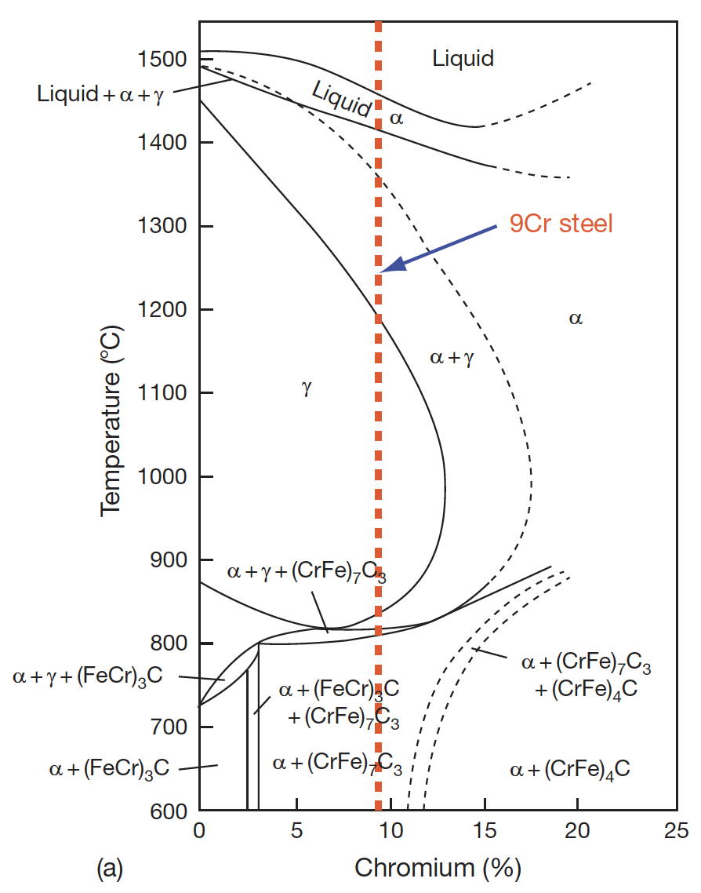
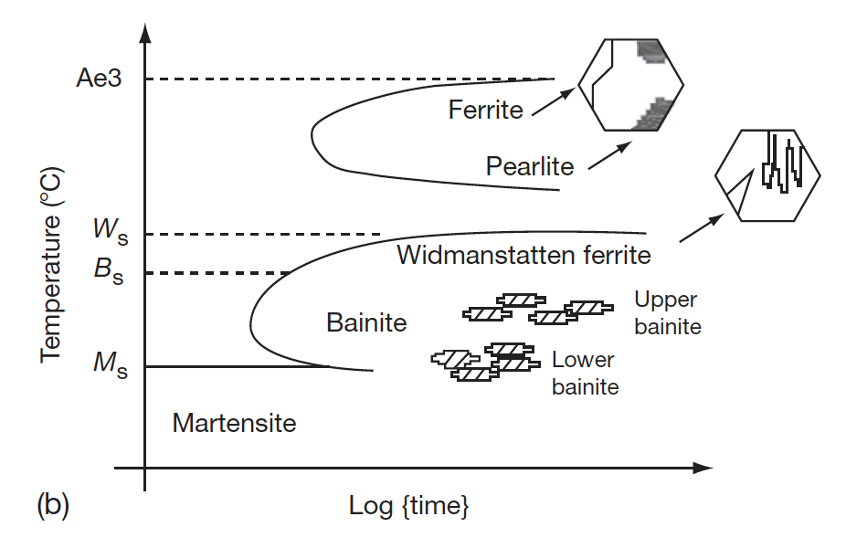
Ferritic-Martensitic Steels
The ability to retain ferrite (bcc Fe) is dependent upon the alloying elements
In addition to Cr and Mo, the amount of Si, V, and C affect the phase boundaries
Accordingly, the 9CrMo family of steels can either be martensitic (9Cr–1MoVNb (T91)), ferritic (12Cr–1MoVW (HT9)) or ferritic–martensitic (9Cr–2Mo–V–Nb (EM12)) steel
TTT diagram of austenite
Pseudo-binary phase diagram with Cr equivalent

Slide 8
Composition Effects
The developed of 9Cr-Mo steels was initially focused on oxidation resistance and creep strength
The optimized initial alloy composition considered was 9Cr, 2Mo, 1W, 0.5Si, with C, B, V, Nb, and Ta in small amounts
A reduction in Cr content lowers the oxidation resistance
Higher Cr content has two effects, 1) it increases the hardenability leading to the formation of martensite, and 2) promotes the formation of δ-ferrite, reducing the toughness
If the W+Mo concentration is kept <3%, creep strength will reduce, while higher amount promotes the formation of δ-ferrite and brittle Fe2Mo Laves phase

Slide 9
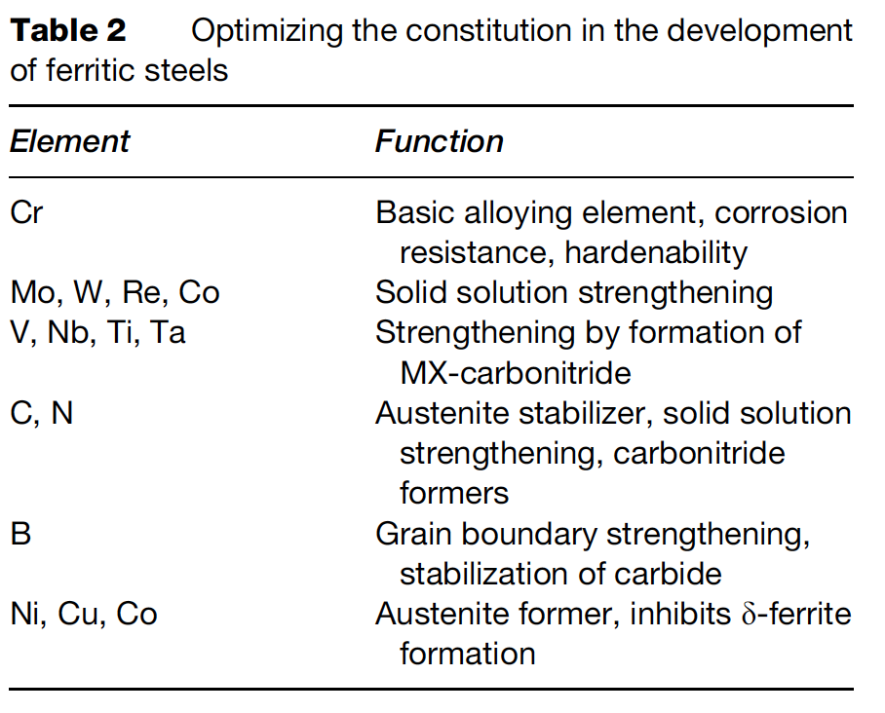
Composition Optimization
The addition or replacement of Mo with W and B increases the stability of M23C6
Lower Ni content introduces δ-ferrite, while its increase reduces creep strength
Lower Si reduces oxidation resistance, while higher Si content leads to agglomeration of carbides
The composition of all other elements can be optimized, based on structure–property correlation studies

Slide 10
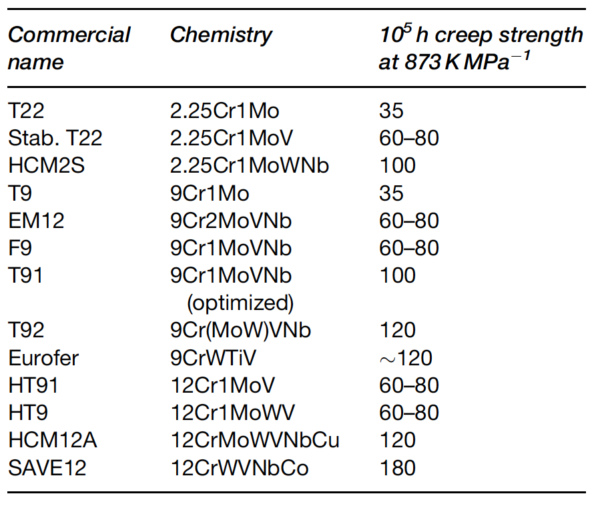
Composition Optimization
The development of high creep-rupture strength steels is based on optimizing the composition, δ-ferrite content, increasing the stability of the martensite, dislocation structure, and maximizing the solid solution and precipitation hardening
Based upon this property tailoring, a large number of alloys have been developed over the last 75 years

Slide 11
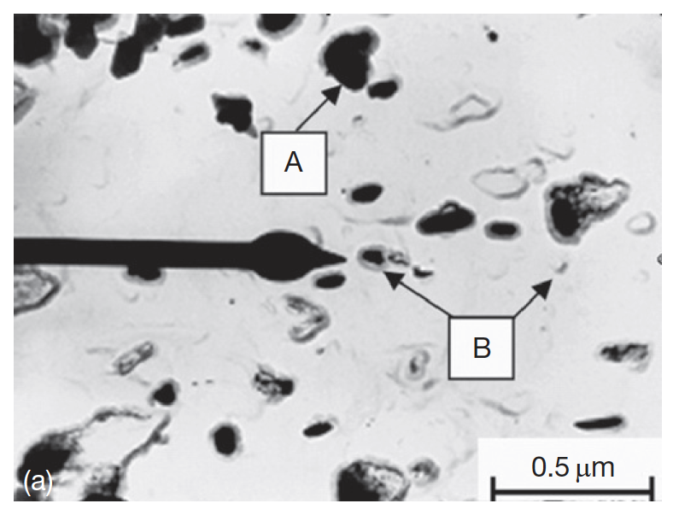
Microstructure
The microstructure of the steels consists of martensite laths containing dislocations and coarse M23C6 particles located at prior austenite and ferrite grain boundaries
Finer carbide precipitates are found within the laths and at the lath/subgrain boundaries
M2X precipitates rich in Cr also form (CrMoWV)2CN

Slide 12
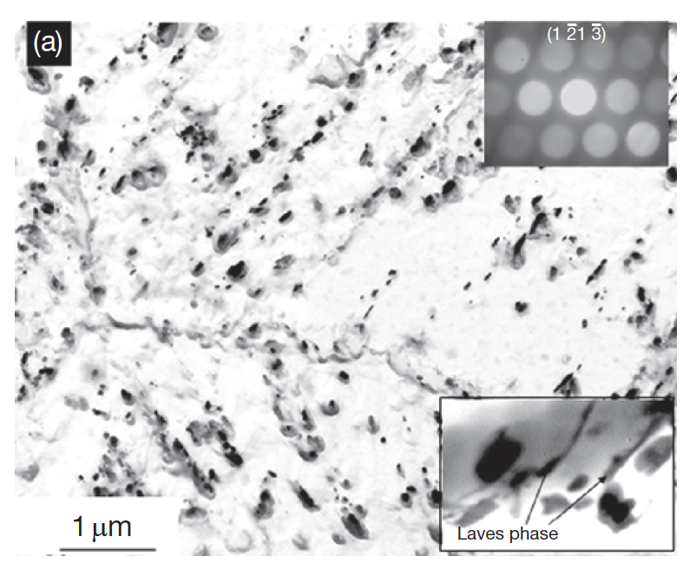
Microstructure
In reactor, this microstructure will change, with the M2X precipitates being replaced by MX intermetallic and Laves phases
There are three types of processes with respect to evolution of secondary phases: irradiation-induced precipitation, irradiation-enhanced transformations, and the irradiation modified phases
The evolution of these phases depends on the composition and structure of the steel and the irradiation parameters like the temperature and fluence

Slide 13
Void Swelling Resistance
Ferritic steels were experimentally observed to exhibit superior radiation resistance compared to austenitic steels
This is largely based on their low swelling behavior
The 9Cr–1Mo steel, modified 9Cr–1Mo (Grade 91), 9Cr–2Mo, and 12Cr–1MoVW (HT9) have low swelling rates at doses as high as 200 dpa
The threshold dose for swelling in ferritic steels is as high as nearly 200 dpa in contrast to 80 dpa for the present generation austenitic stainless steel
HT9 shows 1% swelling at 693 K for 200 dpa

Slide 14
Void Swelling
Void swelling depends crucially on the structure of the matrix lattice, in which irradiation produces the excess defects
There are several reasons why the swelling resistance in ferritic steels is lower than austenitic steels
First, the relaxation volume for interstitials is large in ferrite than in austenite
Thus, for a given interstitial, the strain field is larger in ferrite
This has the impact of more strongly repelling other interstitials, and more strongly attracting vacancies
Second, the migration barrier of vacancies in ferrite is much lower than in austenite (0.55 eV to 1.4 eV)

Slide 15
Void Swelling
Since vacancies are more mobile in ferrite, recombination is more likely with the dispersed isolated interstitials
Additionally, excess vacancies can be trapped at carbide particles
The C-vacancy binding energy in ferrite is twice that in austenite
Finally, the way dislocations and solutes interact in ferrite makes them strong sinks
Given that solutes are oversized substitutionals or interstitials and have a high binding energy with dislocations (often the case), “atmospheres” of solutes can form around dislocations, which are effective sinks for vacancies

Slide 16
Irradiation Hardening

Slide 18
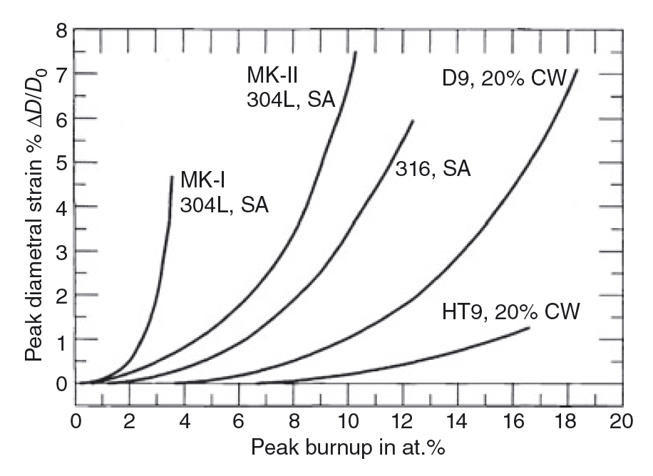
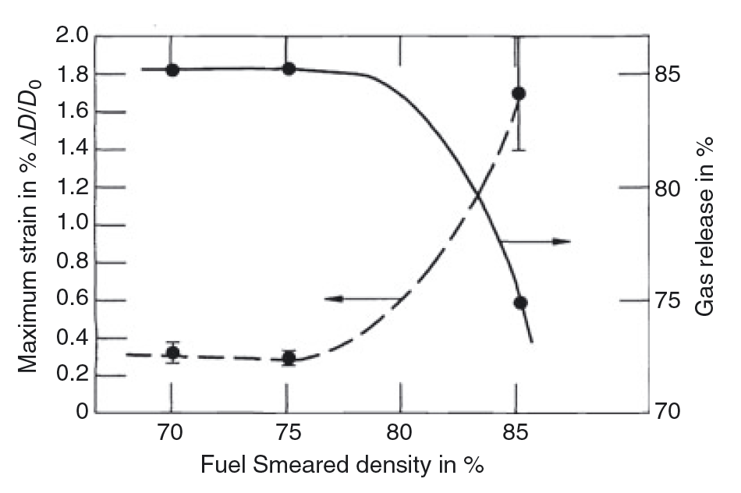
SFR Cladding
HT9 is the current cladding material of choice for SFRs
HT9 is a nonswelling ferritic/martensitic stainless steel
The rate of cladding strain has increased for the initially 85% fuel smeared density elements
12.5% BU

